Slide 1
Material Design
Presentation for GIT MAD
Notes:
Nobody will use an app that doesn’t look good
Even if you plan on doing backend, you will need to design some aspects of your code around the UI
This will go over some UI components and common design patterns that Android developers follow

Slide 2
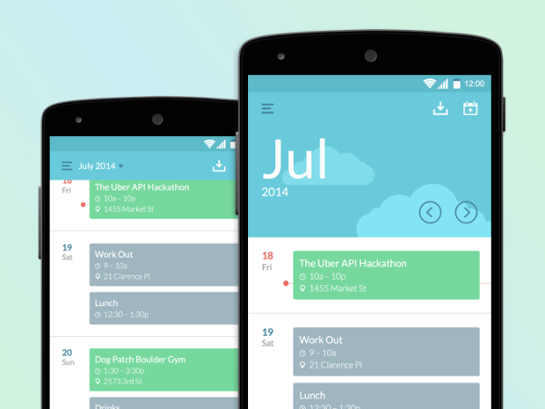
What is Material Design?
A design language developed by Google in 2014
Comprehensive guide to design user interfaces for front-end developers
Most prominently used in Android Apps

Slide 3
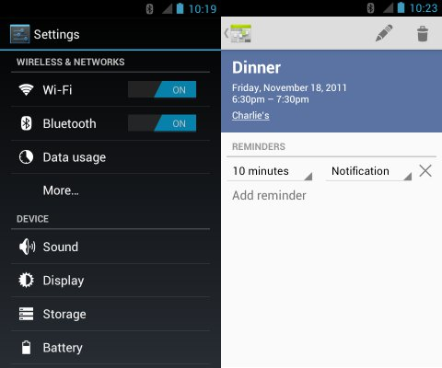
Before Material Design
Before Android Lollipop, apps were “Holo” themed
Came in 2 varieties:
Light
Dark
No guidelines for design
Every app developer created their own version of the theme
Doesn’t look as modern

Slide 4
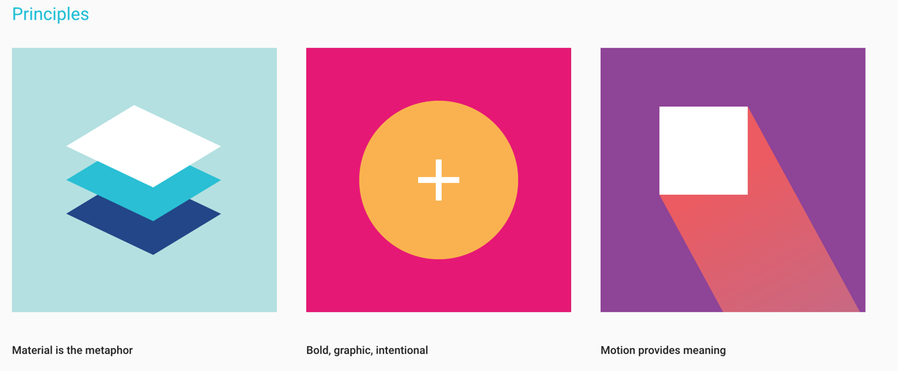
The 3 Principles of Material Design
Notes:
Material is the metaphor = Layers and Light
Bold, graphic, intentional = Style, Color, Space
Motion provides meaning = Animation

Slide 5
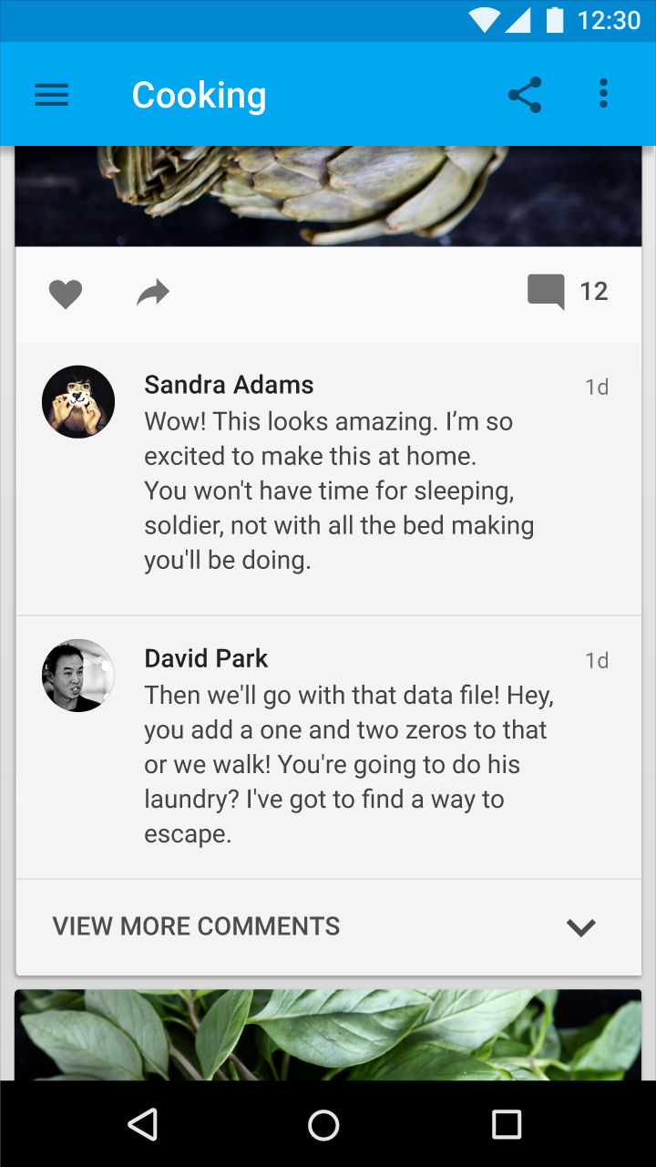
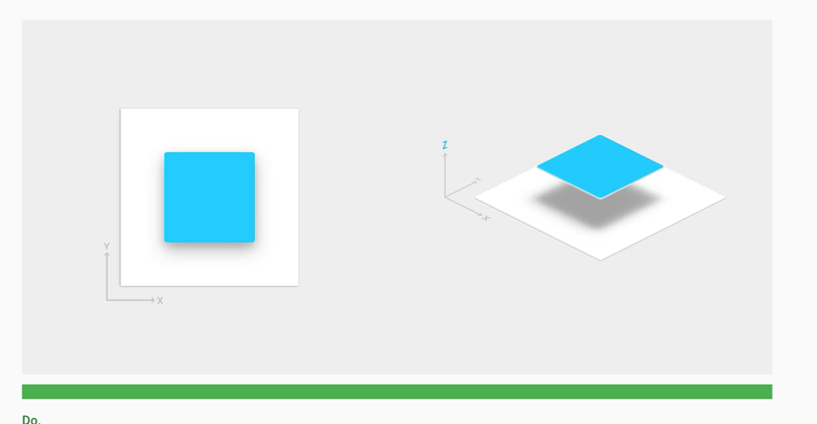
Layers and Lighting
Different UI components are placed on top of each other, creating depth.
Virtual lighting is placed above all the elements, creating shadows.

Slide 6
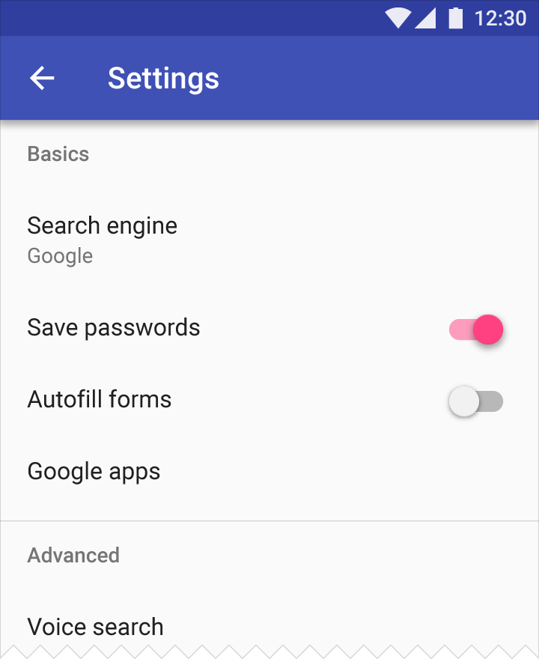
Style and Color
Primary Dark
Primary
Bold colors, large text, and plenty of padding is used to make the UI feel more modern.
Developers pick 3 colors, android will automatically apply it to every UI component:
Primary
Primary Dark
Accent
Accent

Slide 7
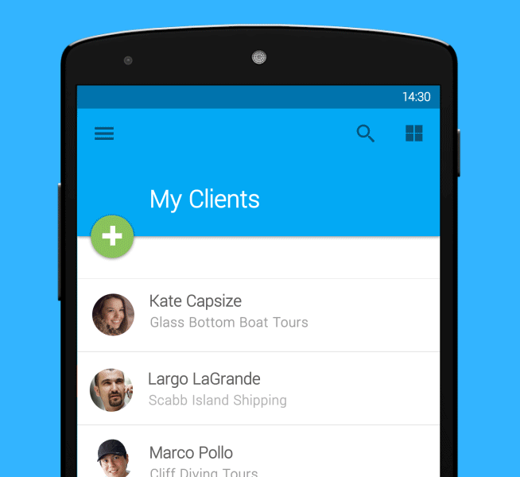
Motion and Animation
Every action provides visual feedback through animation.
Every animation has a purpose and guides the user.
No animation should slow the user down.

Slide 8
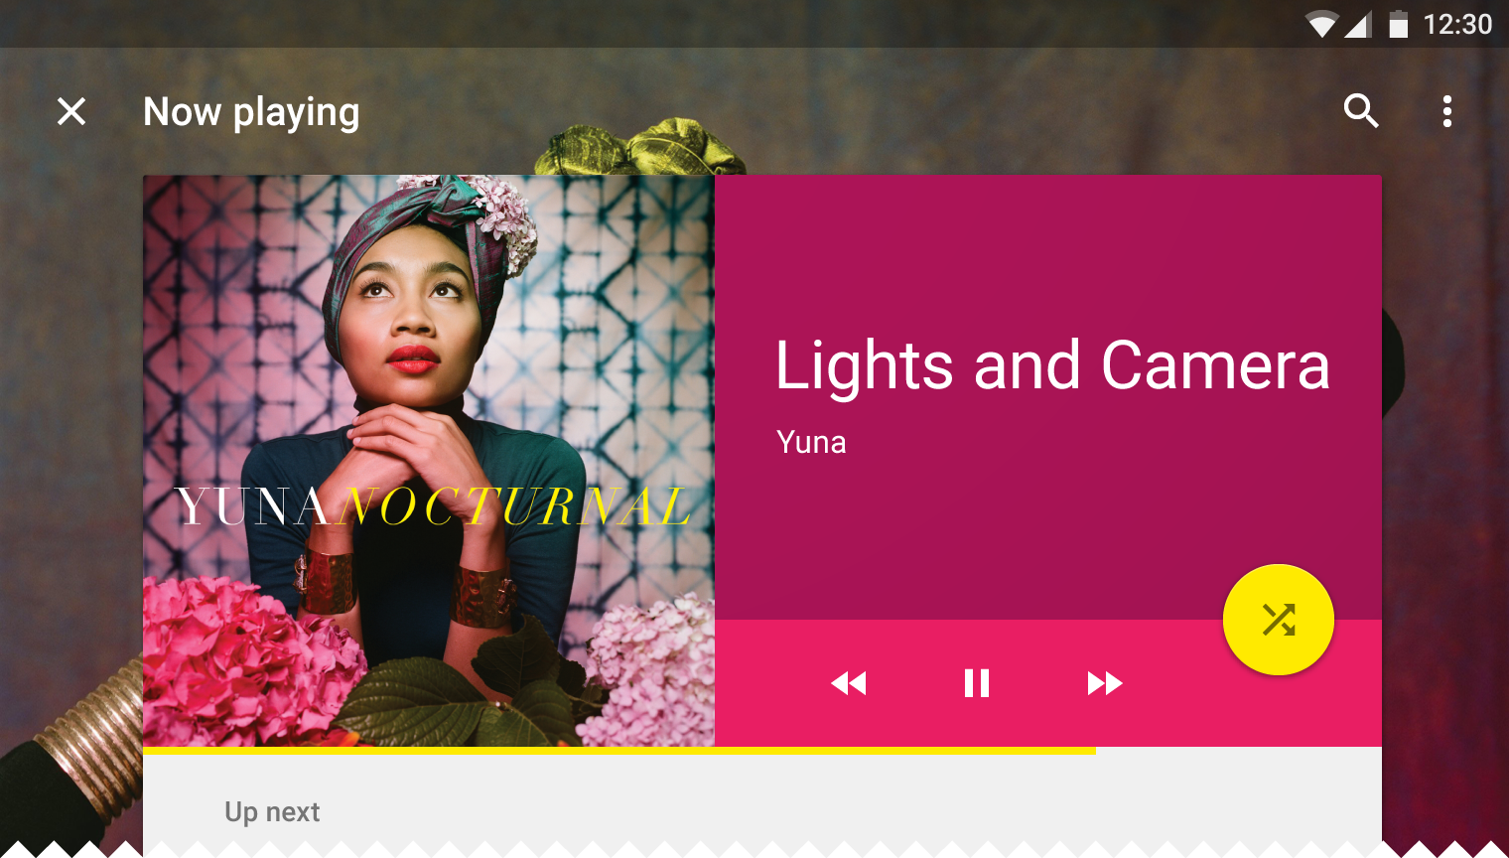
Essential Components

Slide 9
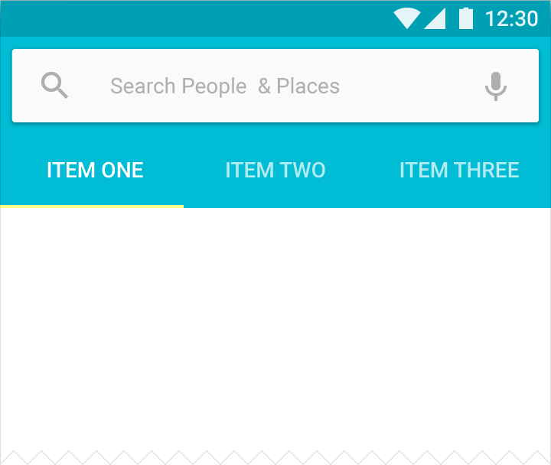
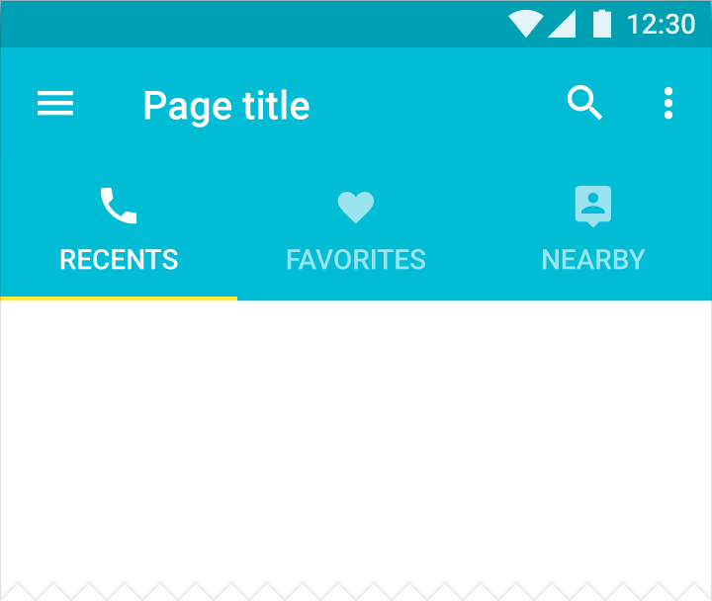
Toolbars and Tabs
Toolbars replace the ActionBar from KitKat
The toolbar supports multiple styles and components:
Back Button
Navigation Drawer
Search Bar
Actions and Overflow Menu
The Tab Bar can be bundled with the Toolbar

Slide 10
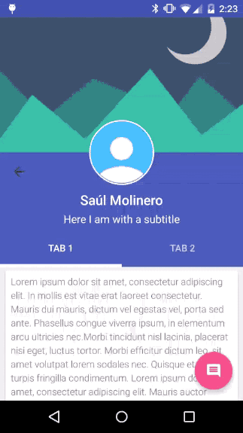
Coordinator Layout
A “super-powered” FrameLayout
Intended for:
A top-level application decor layer
A container for interaction with child views

Slide 11
res/layout/app_bar_main.xml
res/layout/activity_main.xml
<android.support.design.widget.CoordinatorLayout
xmlns:android="http://schemas.android.com/apk/res/android"
xmlns:app="http://schemas.android.com/apk/res-auto"
xmlns:tools="http://schemas.android.com/tools"
android:layout_width="match_parent"
android:layout_height="match_parent"
android:fitsSystemWindows="true"
tools:context="com.example.tnareddy.material.MainActivity">
<android.support.design.widget.AppBarLayout
android:layout_height="wrap_content"
android:layout_width="match_parent"
android:theme="@style/AppTheme.AppBarOverlay">
<android.support.v7.widget.Toolbar
android:id="@+id/toolbar"
android:layout_width="match_parent"
android:layout_height="?attr/actionBarSize"
android:background="?attr/colorPrimary"
app:popupTheme="@style/AppTheme.PopupOverlay"/>
</android.support.design.widget.AppBarLayout>
</android.support.design.widget.CoordinatorLayout>
<include
layout="@layout/app_bar_main"
android:layout_width="match_parent"
android:layout_height="match_parent"/>
MainActivity.java
@Override
protected void onCreate(Bundle savedInstanceState) {
super.onCreate(savedInstanceState);
setContentView(R.layout.activity_main);
Toolbar toolbar = (Toolbar) findViewById(R.id.toolbar);
setSupportActionBar(toolbar);
…
}
Code for the default ToolBar using a Coordinator Layout

Slide 12
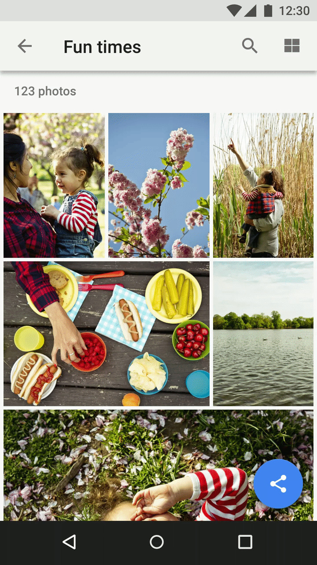
Floating Action Button (FAB)
Used for prominent and common actions
Floats above the other components and stays in a fixed position upon scrolling
Can be expanded by clicking on it
Should be animated

Slide 13
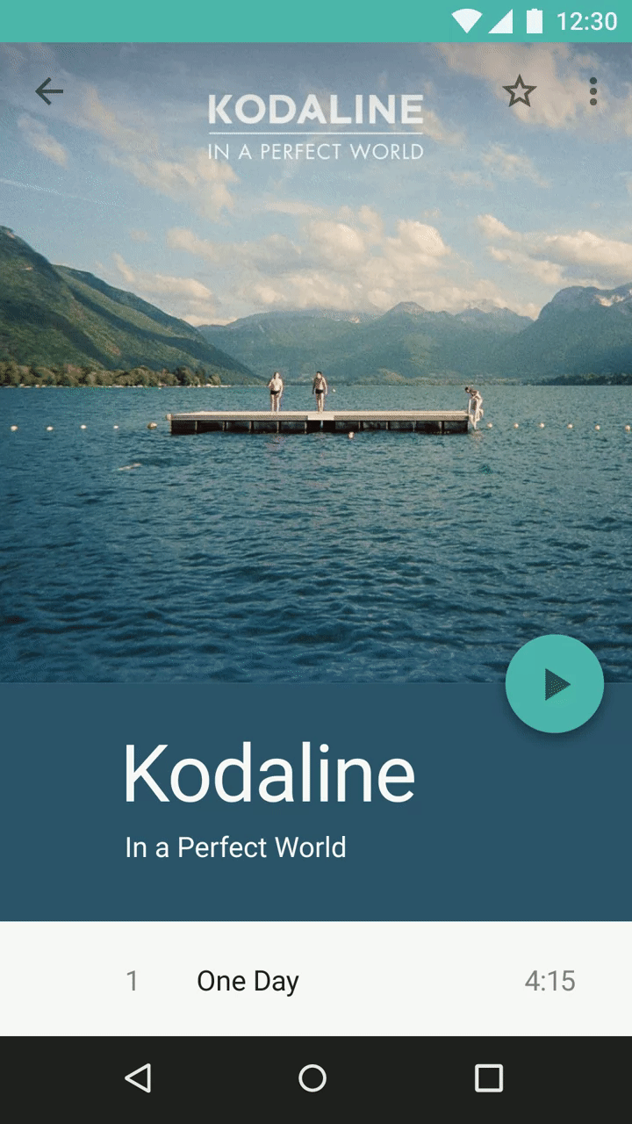
Mini Floating Action Button
Much like the FAB, but can be used in places other than the lower-right corner
Useful for smooth transitions between different Material sheets

Slide 14
res/layout/app_bar_main.xml
MainActivity.java
<android.support.design.widget.CoordinatorLayout
xmlns:android="http://schemas.android.com/apk/res/android"
xmlns:app="http://schemas.android.com/apk/res-auto"
xmlns:tools="http://schemas.android.com/tools"
android:layout_width="match_parent"
android:layout_height="match_parent"
android:fitsSystemWindows="true"
tools:context="com.example.tnareddy.material.MainActivity">
...
<android.support.design.widget.FloatingActionButton
android:id="@+id/fab"
android:layout_width="wrap_content"
android:layout_height="wrap_content"
android:layout_gravity="bottom|end"
android:layout_margin="@dimen/fab_margin"
android:src="@android:drawable/ic_dialog_email"/>
</android.support.design.widget.CoordinatorLayout>
@Override
protected void onCreate(Bundle savedInstanceState) {
…
FloatingActionButton fab = (FloatingActionButton) findViewById(R.id.fab);
fab.setOnClickListener(new View.OnClickListener() {
@Override
public void onClick(View view) {
// Implement an action
}
});
}
Code for the Floating Action Button

Slide 15
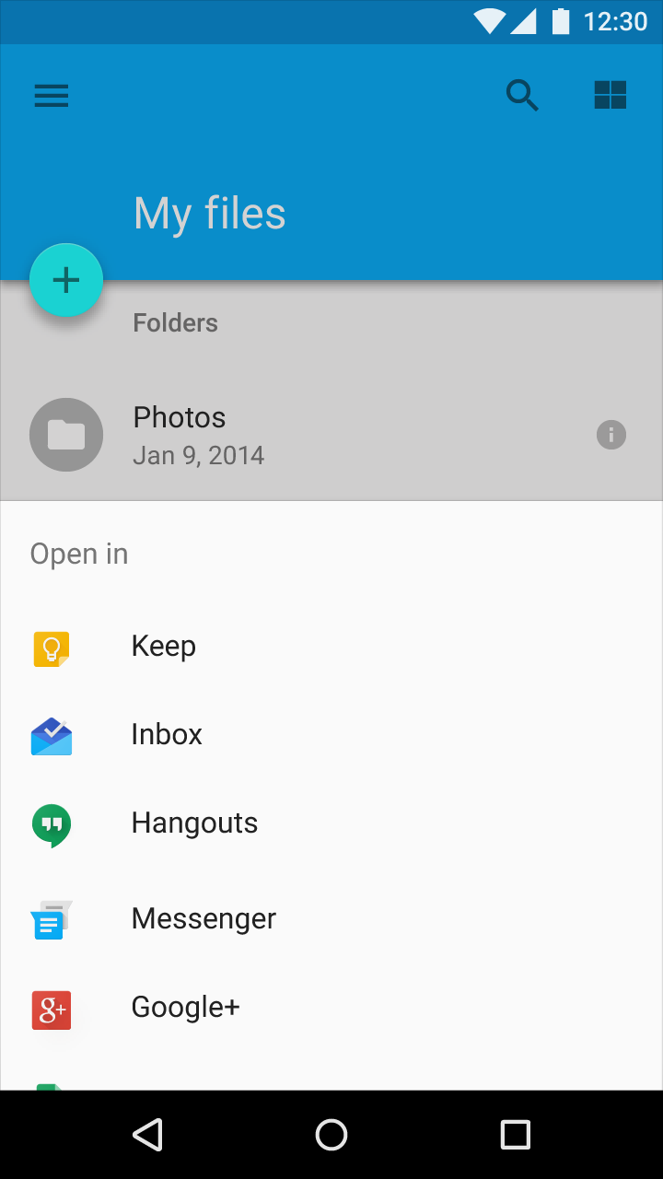
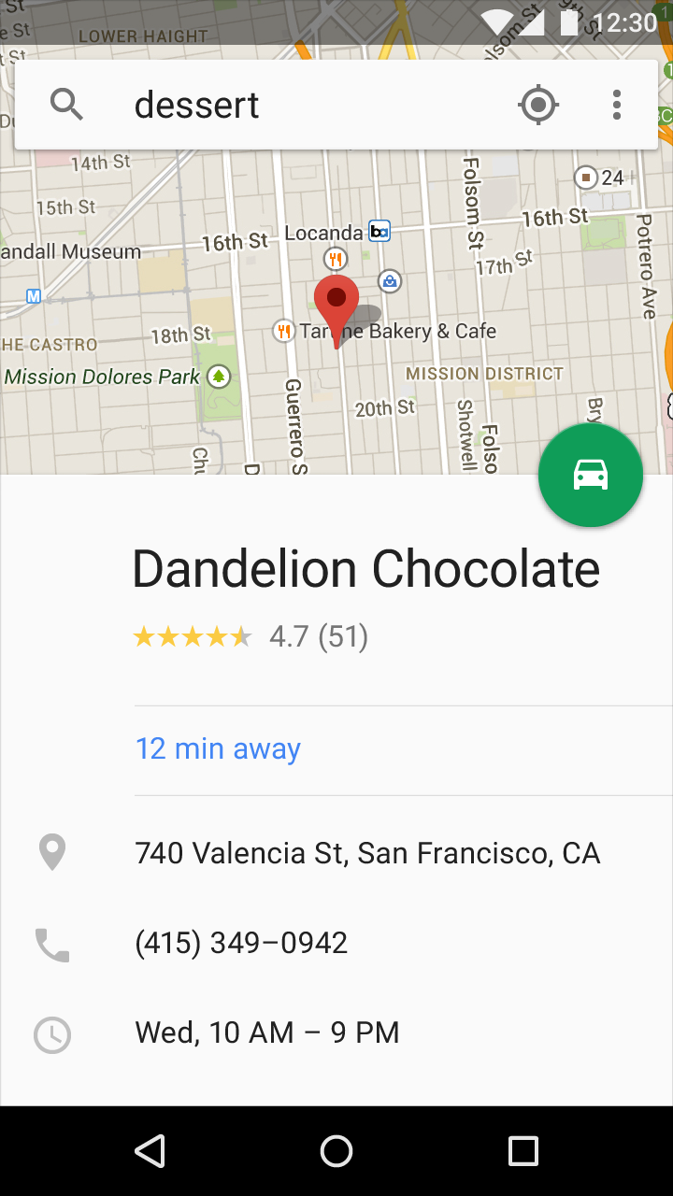
Bottom Sheets
Slide up from the bottom to reveal more content
Modal Bottom Sheets allow for deep-linked sharing between apps and contacts.
Persistent Bottom Sheets display supporting content for the app.

Slide 16
// The View with the BottomSheetBehavior
View bottomSheet = coordinatorLayout.findViewById(R.id.bottom_sheet);
BottomSheetBehavior behavior = BottomSheetBehavior.from(bottomSheet);
behavior.setBottomSheetCallback(new BottomSheetCallback() {
@Override public void onStateChanged(@NonNull View bottomSheet, int newState) {
// React to state change
}
@Override public void onSlide(@NonNull View bottomSheet, float slideOffset) {
// React to dragging events
}
});
Code for Bottom Sheets

Slide 17
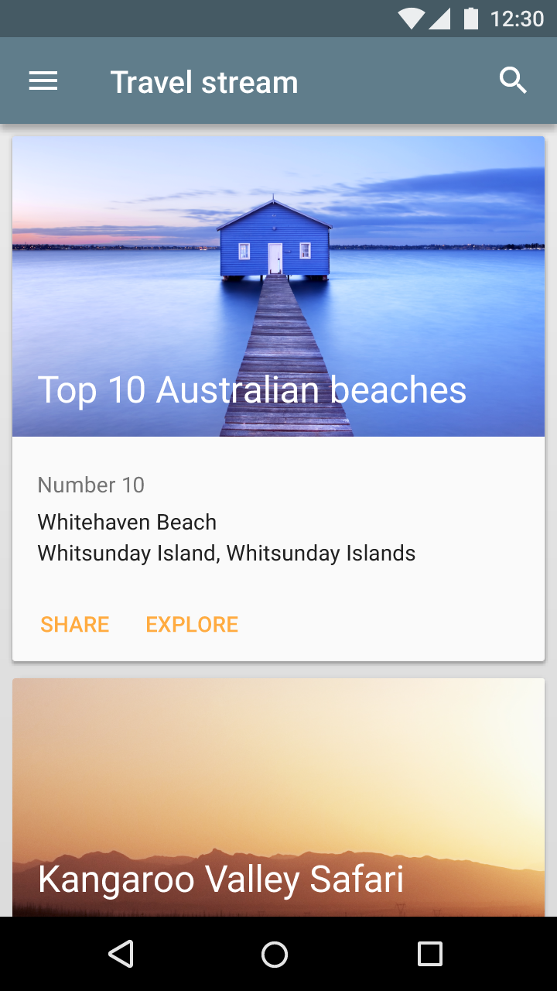
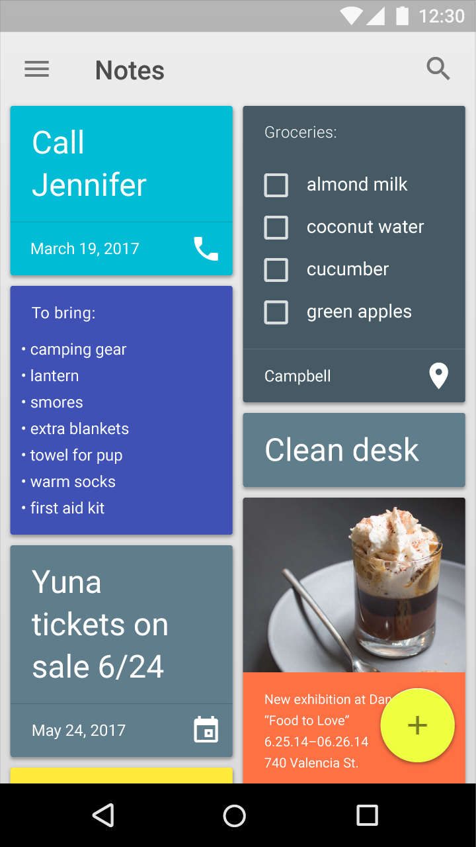
Cards
A sheet of material that encapsulates multiple components with similar content
Useful for displaying a collection of content that is more complicated than just text
Cards are elevated and have rounded corners

Slide 18
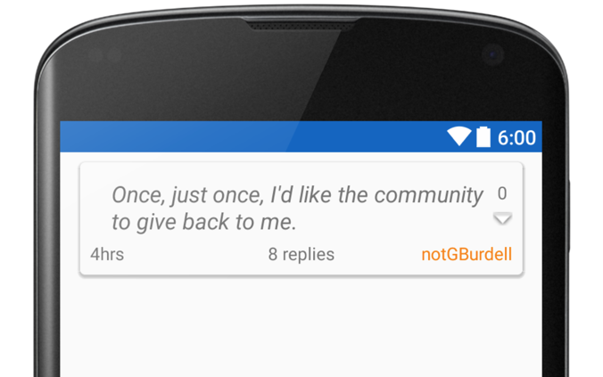
res/layout/view_post.xml
<android.support.v7.widget.CardView
android:layout_width="fill_parent"
android:layout_height="wrap_content"
android:layout_gravity="center"
android:layout_marginBottom="8dp"
android:layout_marginLeft="16dp"
android:layout_marginRight="16dp"
android:layout_marginTop="8dp"
card_view:cardCornerRadius="4dp"
card_view:cardElevation="5dp">
... A layout…
… Content in the layout...
</android.support.v7.widget.CardView>
Code for a Card View

Slide 19
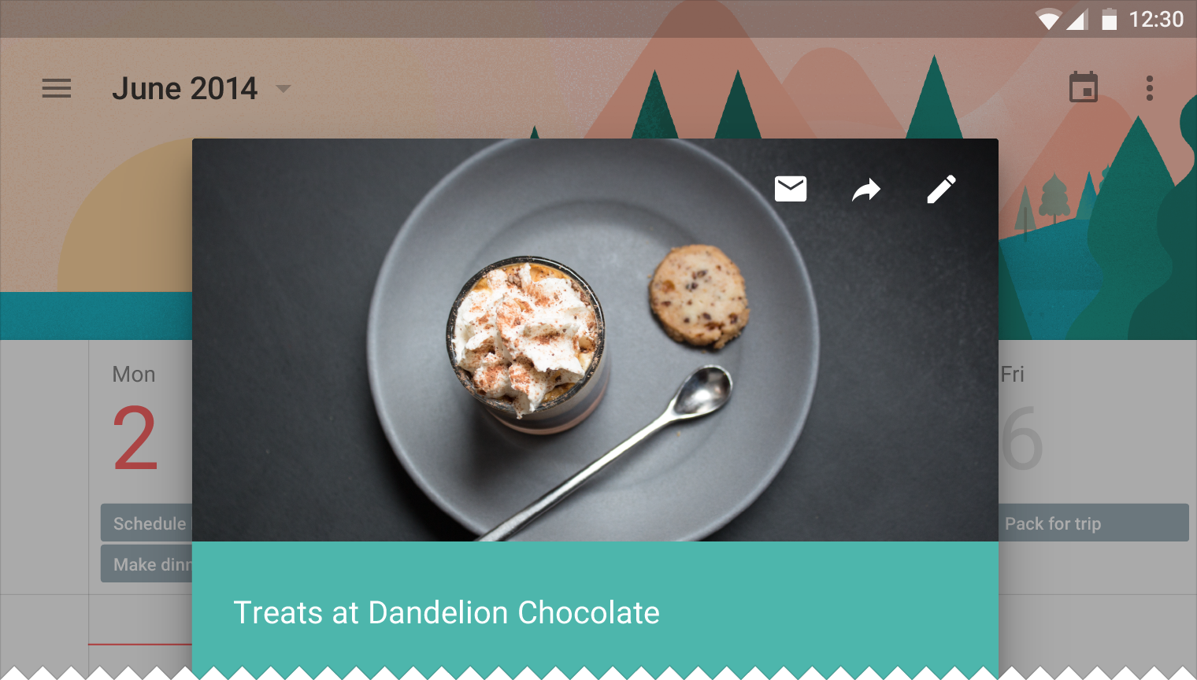
Standard Design Functionality

Slide 20
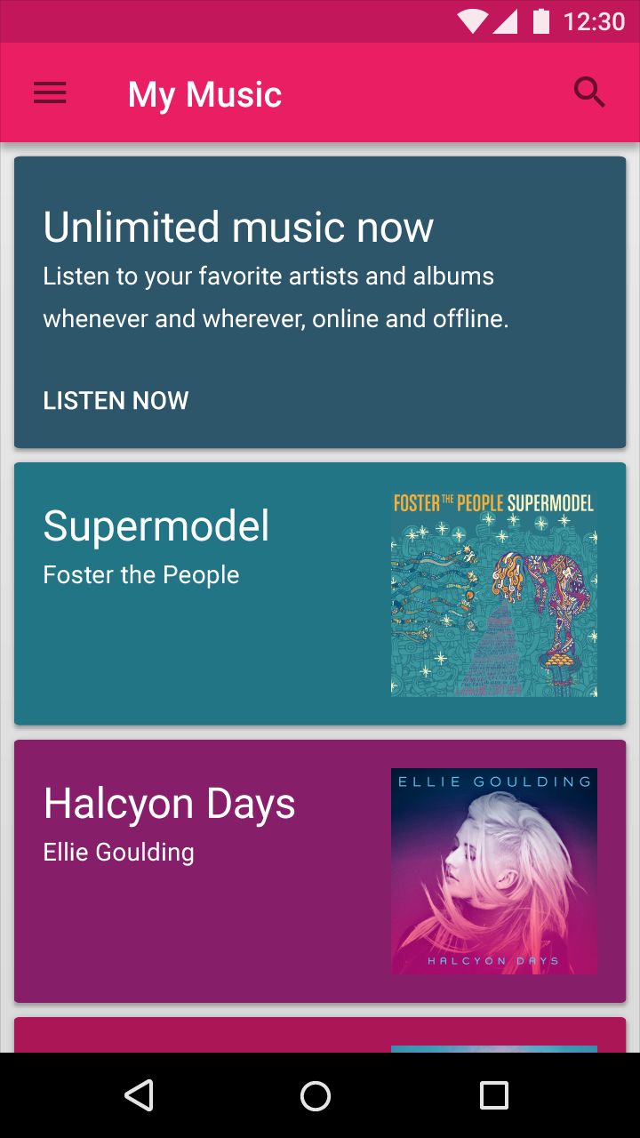
Palette
Dynamically determines the most prominent color in an image
Perfect for coloring the backgrounds of cards based on the content

Slide 21
// Synchronous
Palette p = Palette.from(bitmap).generate();
Palette.Swatch swatch = p.getVibrantSwatch();
// Do something with the swatch (get rgb)
// Asynchronous
Palette.from(bitmap).generate(new PaletteAsyncListener() {
public void onGenerated(Palette p) {
Palette.Swatch swatch = p.getVibrantSwatch();
// Do something with the swatch (get rgb)
}
});
Code for using the Palette

Slide 22
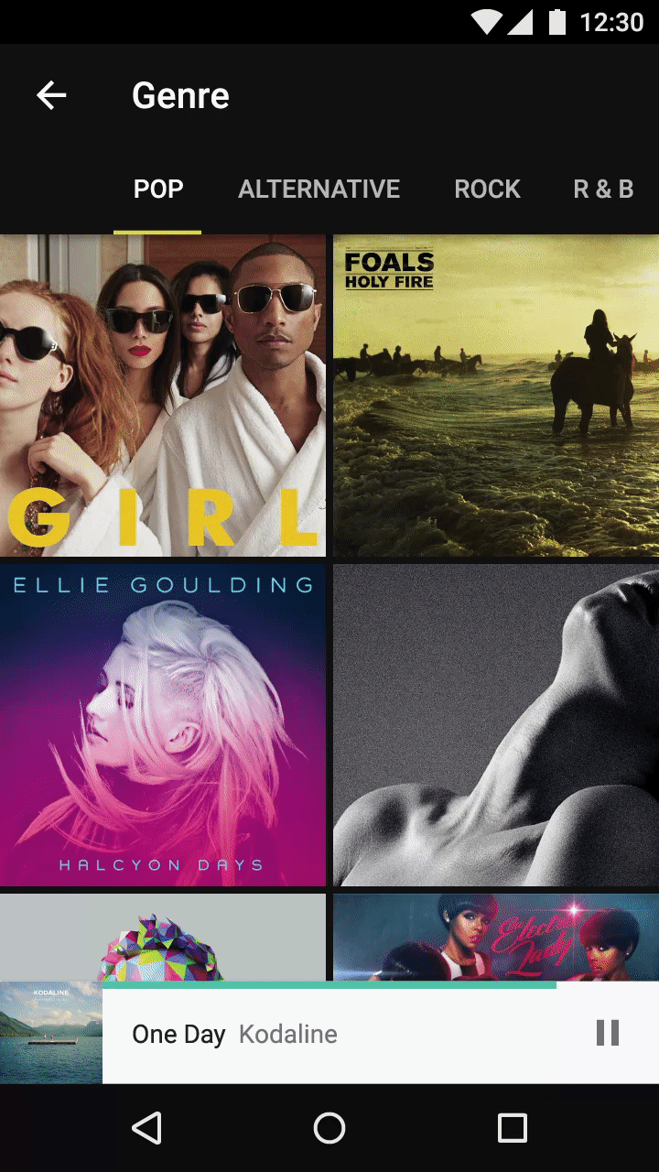
Scrolling Techniques
Collapsible Toolbar
Various components and sheets are collapsible during scrolling
Some components may also float on the screen, indicating they are layered above the scrolling pane.
Scrolling Pane
Floating Sheet
Notes:
No code as it is different for each type of toolbar + appbar combination. Should be able to find online

Slide 23
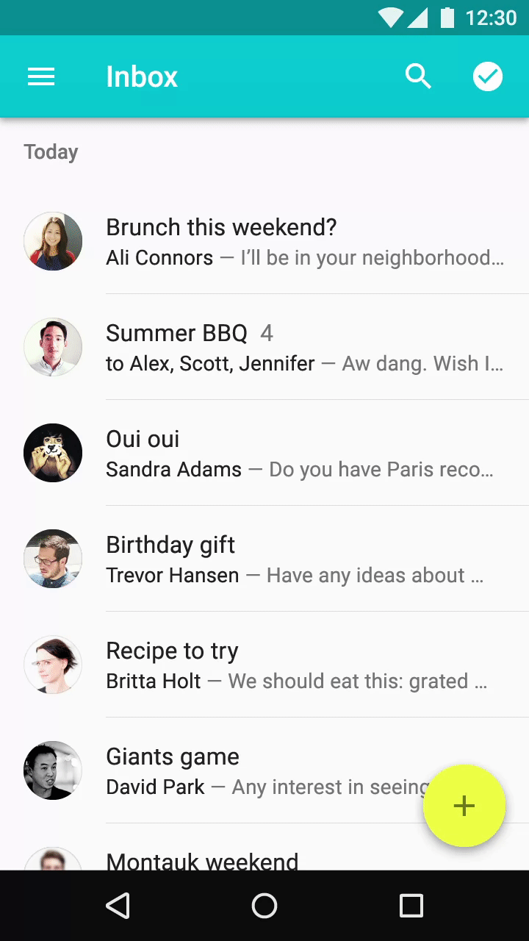
Swipe to Refresh
Swipe down gesture to refresh content.
All lists, grid lists, and recycler views should implement “swipe to refresh”, as it is an intuitive gesture

Slide 24
res/layout/fragment_sorted_posts.xml
SortedPostFragment.java
<android.support.v4.widget.SwipeRefreshLayout
android:id="@+id/swipeRefreshLayout"
android:layout_width="match_parent"
android:layout_height="match_parent">
<android.support.v7.widget.RecyclerView
android:id="@+id/sorted_posts_recycler_view"
android:layout_width="match_parent"
android:layout_height="match_parent"/>
</android.support.v4.widget.SwipeRefreshLayout>
private SwipeRefreshLayout srl;
@Override
public View onCreateView(LayoutInflater inflater, ViewGroup container,
Bundle savedInstanceState) {
…
srl = (SwipeRefreshLayout) view.findViewById(R.id.swipeRefreshLayoutID);
srl.setOnRefreshListener(new SwipeRefreshLayout.OnRefreshListener() {
@Override
public void onRefresh() {
// Refresh the recycler view
srl.setRefreshing(false);
}
});
…
}
Code for Swipe to Refresh

Slide 25
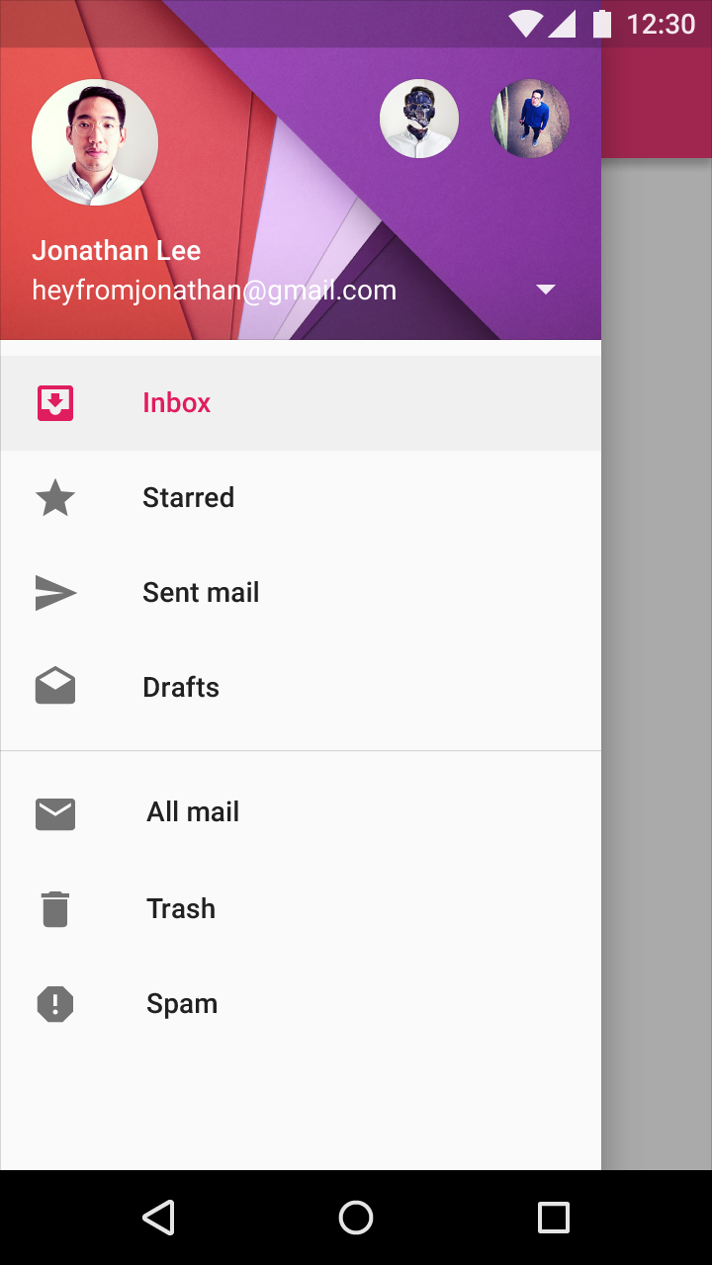
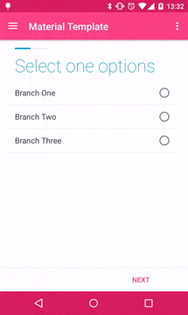
Navigation Drawer
Allows the user to navigate to any top-level fragment from any location in the app
Provides the user with the basic structure of the app
Slides out from the left

Slide 26
res/layout/activity_main.xml
MainActivity.java
<android.support.v4.widget.DrawerLayout
xmlns:android="http://schemas.android.com/apk/res/android"
xmlns:app="http://schemas.android.com/apk/res-auto"
xmlns:tools="http://schemas.android.com/tools"
android:id="@+id/drawer_layout"
android:layout_width="match_parent"
android:layout_height="match_parent"
android:fitsSystemWindows="true"
tools:openDrawer="start">
<include
layout="@layout/app_bar_main"
android:layout_width="match_parent"
android:layout_height="match_parent" />
<android.support.design.widget.NavigationView
android:id="@+id/nav_view"
android:layout_width="wrap_content"
android:layout_height="match_parent"
android:layout_gravity="start"
android:fitsSystemWindows="true"
app:headerLayout="@layout/nav_header_main"
app:menu="@menu/activity_main_drawer" />
</android.support.v4.widget.DrawerLayout>
@Override
protected void onCreate(Bundle savedInstanceState) {
...
DrawerLayout drawer = (DrawerLayout) findViewById(R.id.drawer_layout);
ActionBarDrawerToggle toggle = new ActionBarDrawerToggle(this, drawer,
toolbar, R.string.navigation_drawer_open,
R.string.navigation_drawer_close);
drawer.setDrawerListener(toggle);
toggle.syncState();
NavigationView navigationView = (NavigationView)
findViewById(R.id.nav_view);
navigationView.setNavigationItemSelectedListener(this);
...
}

Slide 27
Support Libraries
The Support Package includes static "support libraries" that you can add to your Android application in order to use APIs that are either not available for older platform versions.
Using the support library Appcompat, we can use all of these Material Design standards for any pre-Lollipop devices.
~50% of Android devices in the market are still running KitKat

Slide 28
Design Resources
Google Material Design Guidelines
Google Material Design Icons
Google Material Design Color Codes
Android Material Design API Documentation
Material Design Color Palette

Slide 29
Coding Time!
Clone the repository: https://github.com/git-mad/MaterialDesignTutorial
Get this powerpoint from the readme on the repo
It will be helpful to look at the slides with the code
Start reading through the comments and working on the code
Ask for help!

